Slide 1
welcome to
COMP 2691
Intermediate Windows Application Development in .NET
Week 10
Reflection
Amir Ahani, M.Sc. + MBA
Microsoft Certified Solution Developer (MCSD .NET)
Microsoft Certified Database Administrator (MCDBA)
Email: amirahani@gmail.com
<number> of 49
Notes:
COMP2690 Windows Application Development with C#

Slide 2
Today…
Understanding Reflection
Assembly Attributes
Reflecting Types
Writing Dynamic Code
Lab: Use the .NET Tools to Examine an Assembly
Lab: Set Assembly Attributes and Display Them at Runtime
Lab: Load an Assembly, and Dump Its Type Information
Lab: Invoke Members through Reflection
<number> of 49
Notes:
COMP2690 Windows Application Development with C#

Slide 3
Understanding Reflection
Reflection
The reflection system in .NET is used to interrogate types in the type system as well as to create code on the fly. At its root, reflection presents code as an object model. From assemblies and models all the way down to the individual statements that are part of a line of code, reflection allows you to both interrogate and generate code in .NET.
<number> of 49

Slide 4
Understanding Reflection
Understanding Assemblies and Modules
Code in the CLR is packaged in an assembly. This metadata is the data that the CLR uses to load and execute code, and it includes type information for all the classes, structures, delegates, and interfaces in the assembly. The type information includes every method, property, event, delegate, and enumeration of each type. Additionally, there is even metadata about the actual code, including the size of the code and any local variables.
<number> of 49

Slide 5
Understanding Reflection
Understanding Assemblies and Modules
Even though it is often thought of as a file, an assembly is actually a logical container for different parts of the data the CLR needs to execute code. These parts include the following:
  Assembly metadata
  Type metadata
  Code (Intermediate Language code)
  Resources
<number> of 49

Slide 6
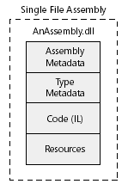
Understanding Reflection
Understanding Assemblies and Modules
Assembly metadata includes data that defined the assembly, such as the name, version, strong name, and culture information. The assembly metadata is also called the manifest. Type metadata is all the information that describes what a type looks like, including the namespace and type names (that is, class names), the individual members of a type (such as methods, properties, and constructors), and their parameters if any. The code is the actual Intermediate Language (IL) code that is compiled to machine code as the assembly is executed. Finally, resources are objects (such as strings, images, or files) that are used from the code. Most of the time, all these parts of an assembly are compiled into a single file.
<number> of 49

Slide 7
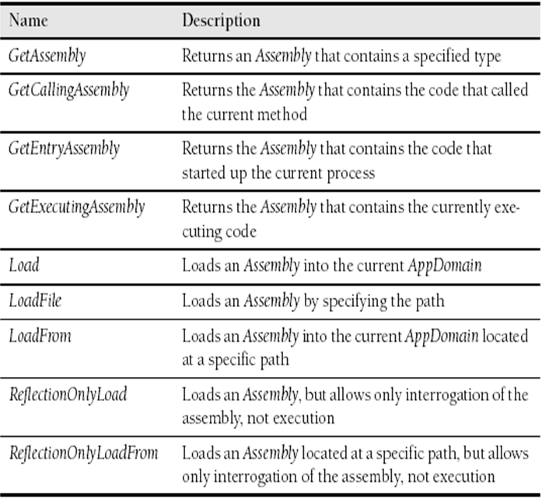
Understanding Reflection
Assembly Class Static Methods
<number> of 49

Slide 8
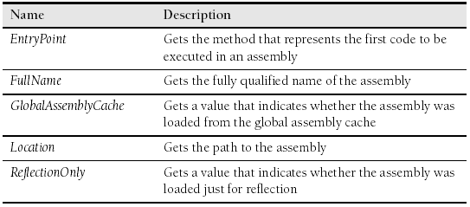
Understanding Reflection
Once you have an instance of the Assembly class, you can interrogate the properties of the assembly itself.
Assembly Class Properties
<number> of 49

Slide 9
Example
Assembly a = Assembly.GetExecutingAssembly();
Console.WriteLine("Full Name: {0}", a.FullName);
Console.WriteLine("Location: {0}", a.Location);
Console.WriteLine("Only Reflection?: {0}", a.ReflectionOnly);
The Assembly class also supports loading assemblies just to interrogate the information in the assembly. The idea here is that when loading an assembly, there is a bit of work involved with reading an assembly to be executed in an AppDomain. At times, you need to load up an assembly to read through its type information, but you do not expect to execute code or create types. To make this process more efficient, the Assembly class now supports the ReflectionOnlyLoad and ReflectionOnlyLoadFrom methods.
<number> of 49

Slide 10
Example
string fullName = "System.Transactions, Version=2.0.0.0, " +
"Culture=neutral, PublicKeyToken=b77a5c561934e089";
Assembly theAssembly = Assembly.ReflectionOnlyLoad(fullName);
Console.Write("Location: {0}", theAssembly.Location);
// Throws an exception because we loaded it for reflection only
object o =
theAssembly.CreateInstance("System.Transactions.TransactionScope");
<number> of 49

Slide 11
Understanding Reflection
Assembly - GetModules
Each assembly contains one or more modules that represent containers for type information. You can ask the Assembly class to return the modules in an assembly by calling the GetModules method.
Assembly a = Assembly.GetExecutingAssembly();
Module[] mods = a.GetModules();
foreach (Module m in mods)
{
Console.WriteLine("Module Name: {0}", m.Name);
}
<number> of 49

Slide 12
Understanding Reflection
The Assembly Module Class
The Module class can be used to retrieve or search for types contained within a specified module. For assemblies originally written in languages that support the notion of modules (for example, Visual Basic), it also supports GetField, GetFields, GetMethod, and GetMethods methods. In those types of modules, fields and methods can be attached directly to a module.
<number> of 49

Slide 13
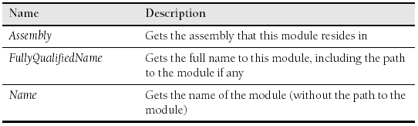
Understanding Reflection
Assembly Module Class Properties
<number> of 49

Slide 14
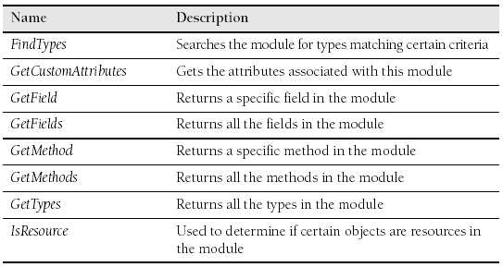
Understanding Reflection
Assembly Module Class Methods
<number> of 49

Slide 15
Lab: Use the .NET Tools to Examine an Assembly
<number> of 49

Slide 16
Assembly Attributes
Assembly Attributes
Now that you have seen the Assembly class, you might notice that there are many pieces of information about an assembly that are not readily available to this class.
These additional pieces of information are captured as part of the assembly as attributes on the assembly. These additional pieces of information include copyright and company information as well as run-time information such as culture and key file information.
<number> of 49

Slide 17
Assembly Attributes
Common Attributes
  AssemblyAlgorithmIdAttribute Class
  AssemblyCompanyAttribute Class
  AssemblyConfigurationAttribute Class
  AssemblyCopyrightAttribute Class
  AssemblyCultureAttribute Class
  AssemblyDefaultAliasAttribute Class
  AssemblyDelaySignAttribute Class
  AssemblyDescriptionAttribute Class
  AssemblyFileVersionAttribute Class
  AssemblyFlagsAttribute Class
  AssemblyInformationalVersionAttribute Class
  AssemblyKeyFileAttribute Class
  AssemblyTitleAttribute Class
  AssemblyTrademarkAttribute Class
  AssemblyVersionAttribute Class
<number> of 49

Slide 18
Assembly Attributes
Getting Assembly Attributes
Setting attributes on an assembly is only part of the job. You also need to be able to get the attributes for an assembly. The main way you can get the attributes is by calling the GetCustomAttributes method on the Assembly class. This method is part of the
ICustom-AttributeProvider interface. The ICustomAttributeProvider interface is used to find what types of objects provide custom attributes. Because of this, the GetCustomAttribute allows for a Boolean value to indicate whether to get inherited attributes. This is a very useful idea, but because GetCustomAttributes is on the Assembly class, the .NET Framework completely ignores the Boolean value (There is no inheritance tree for assemblies).
<number> of 49

Slide 19
Example
Assembly a = Assembly.GetExecutingAssembly();
object[] attrs = a.GetCustomAttributes(false);
foreach (Attribute attr in attrs)
{
Console.WriteLine("Attribute: {0}", attr.GetType().Name);
}
<number> of 49

Slide 20
Example
Get a Specific Attribute
Assembly a = Assembly.GetExecutingAssembly();
Type attrType = typeof(AssemblyDescriptionAttribute);
object[] versionAttrs = a.GetCustomAttributes(attrType, false);
if (versionAttrs.Length > 0)
{
AssemblyDescriptionAttribute desc =
(AssemblyDescriptionAttribute)versionAttrs[0];
Console.WriteLine("Found Description!");
Console.WriteLine("Desc: {0}", desc.Description);
}
<number> of 49

Slide 21
Lab: Set Assembly Attributes and Display Them at Runtime
<number> of 49

Slide 22
Reflecting Types
Reflecting Types
Up to now, we have been delving into the specifics of containers of code, specifically assemblies and modules. In this section, we dive into the heart of the matter and start looking at reflecting through the members of a type.
<number> of 49

Slide 23
Reflecting Types
Getting Types
Before you can start looking at type information, you have to understand how to get Type objects. You can get Type objects in a number of ways:
  From the Assembly class
  From the Module class
  From instances of an object
  Using the typeof keyword in C# or GetType in Visual Basic
<number> of 49

Slide 24
Reflecting Types
GetTypes Method
When working with an Assembly class, you can ask it for all the Types in all the modules of the assembly by calling the GetTypes method:
Assembly a = Assembly.GetExecutingAssembly();
// Get all the types in the Assembly
Type[] assemblytypes = a.GetTypes();
When working with a Module object, you can also ask for all the Types associated with it by calling the Module class’s GetTypes method:
Module[] mods = a.GetModules();
Module m = mods[0];
// Get all the Types from a particular Module
Type[] moduleTypes = m.GetTypes();
<number> of 49

Slide 25
Example
object o = new object();
// Get the Type of an instance
Type objType = o.GetType();
You can create a Type object using the C# typeof keyword or Visual Basic GetType keyword:
Type specificType = typeof(Int32);
<number> of 49

Slide 26
Reflecting Types
Type Class Methods
Name | Description
GetConstructors | Retrieves all the ConstructorInfo objects that are associated with this Type
GetEvents | Retrieves all the EventInfo objects that are associated with this Type
GetFields | Retrieves all the FieldInfo objects that are associated with this Type
GetInterfaces | Retrieves all the InterfaceInfo objects that are associated with this Type
GetMembers | Retrieves all the MemberInfo objects that are associated with this Type
GetMethods | Retrieves all the MethodInfo objects that are associated with this Type
GetProperties | Retrieves all the PropertyInfo objects that are associated with this Type

Slide 27
Reflecting Types
Type Class Properties
Name | Description
Namespace | Gets the namespace for this Type
FullName | Gets a fully qualified name for the Type, without the assembly information
IsValueType | Gets a value that indicates whether this Type is a value type
IsSealed | Gets a value that indicates whether this Type is sealed or not inheritable
IsAbstract | Gets a value that indicates whether this Type refers to an abstract class
IsPublic | Gets a value that indicates whether this Type is public
IsClass | Gets a value that indicates whether this Type refers to a class

Slide 28
Example
Once you get an instance of the Type object, you can use it to get information about the type, like:
Type t = typeof(String);
Console.WriteLine("Type: {0}", t.Name);
Console.WriteLine(" Namespace : {0}", t.Namespace);
Console.WriteLine(" FullName : {0}", t.FullName);
Console.WriteLine(" Is ValueType?: {0}", t.IsValueType);
Console.WriteLine(" Is Sealed? : {0}", t.IsSealed);
Console.WriteLine(" Is Abstract? : {0}", t.IsAbstract);
Console.WriteLine(" Is Public? : {0}", t.IsPublic);
Console.WriteLine(" Is Class? : {0}", t.IsClass);
<number> of 49

Slide 29
Reflecting Types
Enumerating Class Members
Within the Type class, there are methods for getting different parts of a Type, including methods, properties, fields, and events. Each of these parts of a Type is represented by a class within the reflection system that ends with the name Info. Therefore, the class that represents a field is called FieldInfo, the class that represents an event is called EventInfo, and so on. All these info classes derive from a common abstract class called MemberInfo. In fact, the Type class also derives from the MemberInfo class. The Member-Info class contains common functionality. Most of the interesting data about each of the members of a type is contained in the derived classes.
<number> of 49

Slide 30
Example
Enumerating all the properties of a class:
foreach (PropertyInfo prop in t.GetProperties())
{
Console.WriteLine(" {0}", prop.Name);
}
<number> of 49

Slide 31
Example
You can iterate through all the parts of a Type by using the GetMembers
call. This method, which is shown in the following example, returns an array of MemberInfo objects:
foreach (MemberInfo member in t.GetMembers())
{
Console.WriteLine(" {0}: {1}", member.MemberType, member.Name);
}
<number> of 49

Slide 32
Example
You can see the type of member each of these MemberInfo objects is by checking the MemberType enumeration on the MemberInfo class. This enumeration contains all the different types of members that a MemberInfo object can represent.
if (member.MemberType == MemberTypes.Property)
{
PropertyInfo prop = (PropertyInfo)member;
Console.WriteLine(" Property Type: {0}", prop.PropertyType.Name);
}
<number> of 49

Slide 33
Reflecting Types
Understanding the MethodBody
Iterating through the type information as you have done will allow you to look at the structure of a type, but it won’t necessarily allow you to look at the code the type contains. This is where the MethodBody object comes in to play. The MethodBody is a special sort of container that contains local variables and the actual Intermediate Language (IL) instructions that are compiled into machine code at runtime. You get the MethodBody by using the GetMethodBody call on a MethodBase instance (ConstructorInfo or MethodInfo class):
MethodBody body = meth.GetMethodBody();
<number> of 49

Slide 34
Example
Once you have an instance of the MethodBody class, you can get the local variables and the stack size, like so:
The local variables return as an array of LocalVariableInfo objects that contain information about the type of each variable. The name of the variable is not available because the metadata about a type doesn’t keep the name of the variable, only its order.
Console.WriteLine(" MaxStack: {0}", body.MaxStackSize);
foreach (LocalVariableInfo local in body.LocalVariables)
{
Console.WriteLine("Local Var ({0}): {1}",
local.LocalType, local.LocalIndex);
}
<number> of 49

Slide 35
Reflecting Types
Using the BindingFlags
The BindingFlags enumeration is used to control how members of a type are retrieved using the GetMembers methods (as well as the specific methods for each member type). The BindingFlags enumeration is a flagged enumeration, which means that more than one value can be used.
<number> of 49

Slide 36
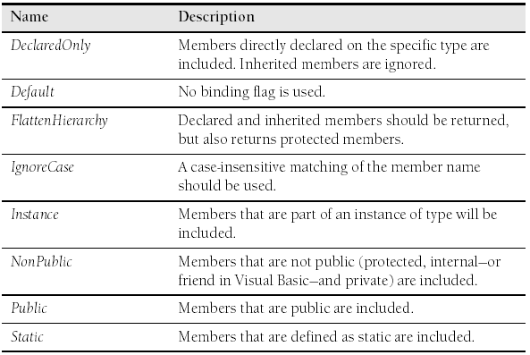
Reflecting Types
Binding Flags Enumeration
<number> of 49

Slide 37
Example
Type t = typeof(String);
// Specify public and non-public, but only instance members
BindingFlags flags = BindingFlags.Public | BindingFlags.NonPublic | BindingFlags.Instance;
// Use the flag to get the members
MemberInfo[] members = t.GetMembers(flags);
foreach (MemberInfo member in members)
{
Console.WriteLine("Member: {0}", member.Name);
}
<number> of 49

Slide 38
Lab: Load an Assembly, and Dump Its Type Information
<number> of 49

Slide 39
Writing Dynamic Code
Up to now, you have been looking at type information in an assembly and reporting it to users. At times, you will want to be able to run code in those assemblies. And there are times when you do not have access to code during compile time. Being able to dynamically load an assembly and run code in that assembly without early access to the code is the goal of dynamic code. The reflection system allows you to create objects dynamically, even from assemblies you have not referenced ahead of time. Although this is more difficult than writing type-safe compiler-checked code, at times it is necessary.
<number> of 49

Slide 40
Writing Dynamic Code
Using Dynamic Code
The following example uses the Hashtable, which most applications already contain references to because the mscorlib assembly is required by nearly every .NET application. The usual case for creating dynamic code is when you need to load code that you have not referenced in your application.
Hashtable tbl = new Hashtable();
tbl.Add("Hi", "Hello");
Console.WriteLine("Hash count: {0}", tbl.Count);
<number> of 49

Slide 41
Example - Hash Table
1- Creating Objects
1-1. The first step is getting the type information:
1-2. Once you have the type, you can ask it for a ConstructorInfo object to use to construct your new type:
string path = @"C:\WINDOWS\Microsoft.NET\Framework\v2.0.50727\" +
"mscorlib.dll";
// Get the assembly
Assembly theAssembly = Assembly.LoadFile(path);
// Get the Hashtable type
Type hashType = theAssembly.GetType("System.Collections.Hashtable");
Type[] argumentTypes = Type.EmptyTypes; // Empty Constructor
ConstructorInfo ctor = hashType.GetConstructor(argumentTypes);
OR
// One argument of type int
Type[] argumentTypes = new Type[] { typeof(int) };
ConstructorInfo ctor = hashType.GetConstructor(argumentTypes);
<number> of 49

Slide 42
Example - Hash Table
1-3. Once you have the ConstructorInfo object, creating an object is as simple as invoking the constructor. Here is how to invoke the empty constructor:
object newHash = ctor.Invoke(new object[] {});
<number> of 49

Slide 43
Example - Hash Table
2- Invoking Members
2-1. Once you have an instance of an object, you simply use reflection to get the info class you need to call, and then you invoke the info class to execute the code.
2-2. You can now use the PropertyInfo class to get the count of the items in your Hashtable to verify that the Add worked as you expected it to:
MethodInfo meth = hashType.GetMethod("Add");
meth.Invoke(newHash, new object[] { "Hi", "Hello" });
PropertyInfo prop = hashType.GetProperty("Count");
int count = (int) prop.GetValue(newHash, null);
<number> of 49

Slide 44
Example - Hash Table
3- Invoking Static Members
Not all dynamic code requires that you have an instance of a class. When you need to dynamically call static methods, you can skip creation of an object. For example, you can get the type of the System.Console class and grab the MethodInfo for WriteLine (a static method):
Because this is a static method, you specify a null in the parameter that would ordinarily take the instance of the object on which to run the method.
Type consoleType = typeof(Console);
MethodInfo writeLineMethod =
consoleType.GetMethod("WriteLine", new Type[] { typeof(string) });
writeLineMethod.Invoke(null, new object[] { count.ToString() });
<number> of 49

Slide 45
Writing Dynamic Code
The Binder Class
When using dynamic code, you can construct your own Binder class that is responsible for determining how to do type conversions and where to locate dynamic code. An instance of the Binder class is an optional argument to the methods of the Type class that return members of a type. If a custom instance of the Binder class is not specified, the system uses its default binder. A custom Binder class is useful if you expect to have to do type conversions or other parameter matching to find the correct method, property, or events when trying to find the implementation of an info class.
<number> of 49

Slide 46
Lab: Invoke Members through Reflection
<number> of 49

Slide 47
Summary
  Assemblies are containers for modules, and modules are containers for types.
  To access assemblies that are related to the currently running code, load ad-hoc assemblies, and list the modules in an assembly, use the Assembly class.
  To specify assembly metadata, use common assembly attributes.
  Query an assembly for individual attributes.
<number> of 49
Notes:
COMP2690 Windows Application Development with C#

Slide 48
Summary
  To access type information directly from any object, call the GetType method of the Object class.
  To enumerate type members, including methods, properties, fields, events, and enumerations, use the MemberInfo and MemberInfoCollection classes.
  To enumerate all the types in a particular assembly, call the GetTypes method of the Assembly class.
  To have more control over what members to retrieve from a Type, use the Binding-Flags enumeration.
<number> of 49
Notes:
COMP2690 Windows Application Development with C#

Slide 49
Summary
  To create a new instance of a type, use the Type class and the ConstructorInfo class.
  To execute arbitrary code for a specific instance of a type, use the MemberInfo classes.
  To execute static code that is associated with a specific type, use the MemberInfo classes.
<number> of 49
Notes:
COMP2690 Windows Application Development with C#

